Slide 1

RAFT : A CONSENSUS ALGORITHM
Project Presentation On
18 May, 2021
Presented By
Mohd Asif Khan Khaishagi - 013
Nitin Sharma - 017
Presented To
Dr. Ananthanarayana V. S.

Slide 2

AGENDA
Consensus Algorithm
Replicated State Machine
Raft : Overview
Environment Details
Implementation Goals
Goal 1 : Leader election
Goal 2 : Ideal Workflow and Logs structure
Goal 3 : Safety and Consistency
Our Contribution
Demo
Observation and Result

Slide 3
CONSENSUS ALGORITHM
“Consensus = Agreement”
A fundamental problem of distributed system is achieving overall system reliability in case of some faulty processes.
Hence requirement is to establish coordination between these processes.to reach a consensus.
Consensus involves multiple systems agreeing on values to perform some task. Once they reach a decision on a value, that decision is final.
GOAL of Consensus Algorithm :
Safety : Return correct result always
Available : Works as long as majority of nodes are running
Does not depend on time consistency.

Slide 4
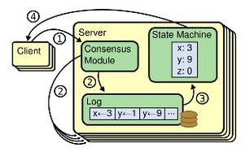
REPLICATED STATE MACHINES
What ? : A general approach to building fault-tolerant system.
Each server has a state machine and a log. The state machine is the component that we want to make fault-tolerant (eg : Hash table).
Each state machine takes as input commands from its log.
A consensus algorithm is used to agree on the commands in the servers' logs.
The consensus algorithm must ensure that all server execute same command in same order.

Slide 5
RAFT : OVERVIEW
RAFT is a consensus algorithm to handle replicated log and is designed in such a way that it is easy to understand.
RAFT Sub-Problems :
Leader Election : re-elect leader in case of existing leader fails
Log Replication : leader handles all the operations from clients and replicates them into all the other nodes.
Safety and Consistency after leader changes.

Slide 6
RAFT : KEY FEATURES
Strong Leader
Log entries flow only from leader to other server.
Makes management and replication of logs easier.
Leader Election
Uses randomized Timers.
Atmost, 1 leader can be elected in a given term.
Log Matching
All machines maintain safe logs till any particular index.
Two logs identical at a particular index will have same entries upto that point.
State Machine Safety
If a server has applied log entry at a given index to its state machine, no other server can replace that index.
Also, all other server will have same log entry at that index.

Slide 7
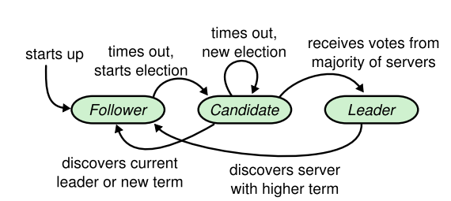
RAFT : NODE STATES
RAFT has three basic states for server and at a point of time server can behave like one of them.
Leader : handles all client interactions, log replication. At most 1 viable leader at a time.
Follower : completely passive (issues no RPCs, responds to incoming RPCs)
Candidate: used to elect a new leader.
Leader keeps sending heartbeats after a definite interval to ensure its authority is known to all.

Slide 8
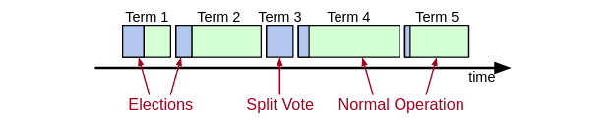
RAFT : TERMS
We need a mechanism to detect obsolete information to achieve consensus.
TIme in our case has been divided into Terms.
There can be only one leader per term.
Each term has a Election AND Split vote OR Normal execution phase.
Split vote arises in a case when we are not able to come up with leaders.
Term is always included in communication between servers.
Machine with lower term, that machine has to update its term and is bound to become follower.

Slide 9

ENVIRONMENT DETAILS
Coding Language : Go
Operating System : Ubuntu 20.04 for development
Tools :
RabbitMQ for distributed message passing
Google cloud for virtual machine deployment.

Slide 10

IMPLEMENTATION GOALS
Implementation goals includes understanding and coding sub-problems associated with RAFT algorithm.
Leader Election : Basic Leader Election, Election safety and liveness.
Normal Flow of Execution
Ideal Workflow
Log Consistency and append entries
Safety and Consistency after Leader re-election : Safety property, Log inconsistencies
OUR CONTRIBUTION : In-memory log replication

Slide 11
LEADER ELECTION
Whenever a node doesn’t receive heartbeat for some Timeout amount of time. It will become a candidate node.
A candidate node increments its term and sends vote request to all the other node and also votes for itself.
A follower node V, not participating in candidacy, will send a negative vote if
In case a candidate node receives a negative vote, it understands there is someone else who is more suited to become a leader wrt follower node.
On receipt of positive vote from majority of nodes. A candidate will become a leader.
Leader will have “most complete” log among electing majority
(lastTerm_{V} > lastTerm_{C}) || (lastTerm_{V} == lastTerm_{C}) && (lastIndex_{V} > lastIndex_{C})

Slide 12
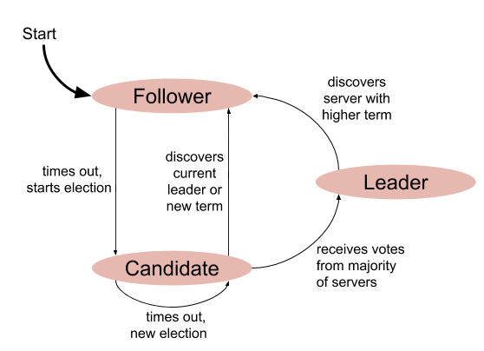
LEADER ELECTION - CORRECTNESS
Election Safety
Since each server gives only 1 vote per Term, 2 different candidates cannot achieve majority.
In case no leader is elected, re-election takes place.
Election Liveness
One of the candidate node is bound to win as random timeout function is used.

Slide 13
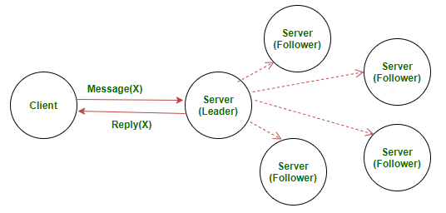
IDEAL WORKFLOW
Whenever some client wants to commit to logs, it always sends the command to the leader.
The leader will append command to its log.
After this, leader sends AppendEntries RPC message to all its followers.
When the command is replicated at half of the nodes, it will be committed.
Client is notified of the commit by the leader.
In case of a crashed or slow follower, leader will retry RPCs until they get completed.

Slide 14
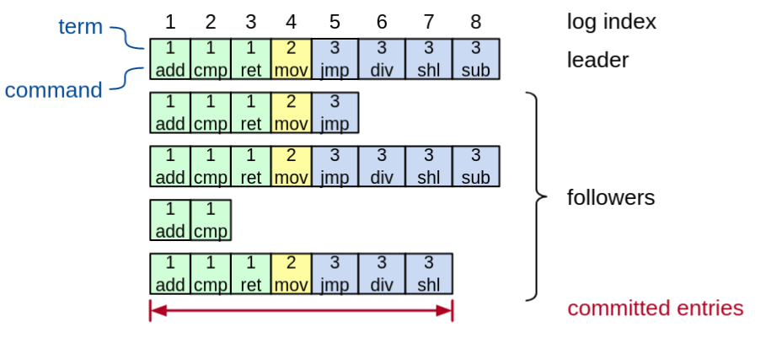
LOG STRUCTURE
Log entry = {index, term, command}
Log stored on stable storage (disk); survives crashes
Entry committed if known to be stored on majority of servers

Slide 15
SAFETY PROPERTY
Requirement : Once a log entry has been applied to a state machine, no other state machine must apply a different value for that log entry.
Raft safety property : If a leader has decided that a log entry is committed, that entry will be present in the logs of all future leaders
This guarantees following :
Leaders never overwrite entries in their logs
Only entries in the leader’s log can be committed
Entries must be committed before applying to state machine

Slide 16
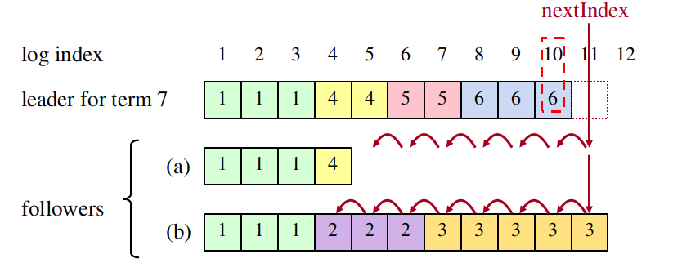
REPAIRING INCONSISTENT LOGS
New leader must make follower logs consistent with its own by removing extra entries and filling missing entries.
Leader will trace back to the point in logs till where a match is found.
In case there were no extra logs in follower, it will simply fill the missing ones.
In case extra extra/erroneous logs were found, leader will delete these extra logs and than bring the follower to its own state.

Slide 17
OUR CONTRIBUTION
We tried to remove the role of disk I/O operations which were there in case of log files.
We removed logs and performed all the operations in-memory in hope of reducing time for disk IO.
This makes system less fault tolerant but more fast. But if majority of nodes are running logs are still safe.
Suggested optimization : if we timely flush out the in-memory logs to log files on disk, but not as frequently as suggested in original approach. [Proposal/Not implemented]
Observations :
With our change of storing logs in memory there is slight reduction of log copying time.
The Leader Re-election time remains almost same. Since we compare only term and index with each other to decide whether to vote positive or not in both the cases.

Slide 18

WORKING DEMO

Slide 19
RESULTS
Original | Our Modification Without Log Files (In memory Logs)
Command Copying Time : 514ms (avg) | Command Copying Time : 497ms (avg)
Leader Re-Election : 3.2ms (avg) | Leader Re-Election : 3.0ms(avg)
255 | 516 | 395 | 933 | 584 | 198 | 675 | 576 | 258 | 758
629 | 633 | 97 | 794 | 540 | 601 | 378 | 188 | 520 | 595
4 | 4 | 3 | 2 | 3 | 4 | 2 | 3 | 3 | 4
2 | 4 | 4 | 2 | 3 | 2 | 3 | 3 | 4 | 3

Slide 20
REFERENCES
Diego Ongaro, & John Ousterhout (2014). In Search of an Understandable Consensus Algorithm. In 2014 USENIX Annual Technical Conference (USENIX ATC 14) (pp. 305–319). USENIX Association.
Lamport, L. (2001). Paxos Made Simple. ACM SIGACT News (Distributed Computing Column) 32, 4 (Whole Number 121, December 2001), 51-58.
Rafailescu, M., & Petrescu, M. (2017). Fault Tolerant Consensus Protocol for Distributed Database Transactions. In Proceedings of the 2017 International Conference on Management Engineering, Software Engineering and Service Sciences (pp. 90–93). Association for Computing Machinery.
Wood, A. (2016). Rabbit MQ: For Starters. CreateSpace Independent Publishing Platform.
Westrup, Erik & Pettersson, Fredrik. (2014). Using the Go Programming Language in Practice.

Slide 21
THANK YOU!

